Slide 1
AJ Montes
MIS 665 Final Project

Slide 2

Project description & Introduction
To Predict who is likely to renew season tickets
Strong Correlations
Notes:
Being able to predict sales plays a high significance

Slide 3
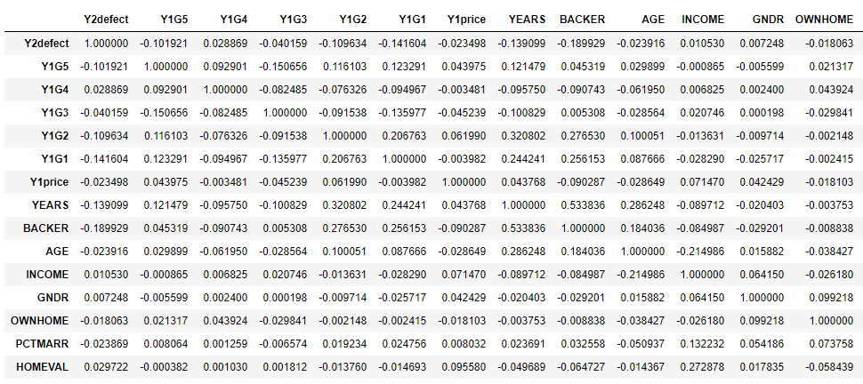

Slide 4
Analysis
Decision Tree Classifier gave me a 0.6049
Using Variables Y1price, BACKER, YEARS, GNDR, Y1G5

Slide 5
Story telling
Who is likely to renew “season ticker”?
Who is likely to defect?

Slide 6
Recommendations
What actions do you recommend K-State Athletic Department (or other sports teams) to take?
What additional variables would you need to improve the model prediction?
Suggestions

